Slide 1

Structured Extraction from Catering Offer Emails
Automating the extraction of key offer details from unstructured email text using NLP techniques

Slide 2

The Challenge
Manual Offer Comparison Creates Bottlenecks
Current Reality
Key Challenges
Event organizers send RFPs to multiple catering suppliers
Unstructured text: Different writing styles across suppliers
Offers arrive as free form emails with varying formats
Format variability: Prices, dates, policies appear in different places
Manual extraction into spreadsheets is time consuming and error-prone
Missing information: Fields may be implicit or omitted entirely
Critical details may be missed or misinterpreted
Inconsistent units: "around 200 per person", "+VAT", ranges

Slide 3
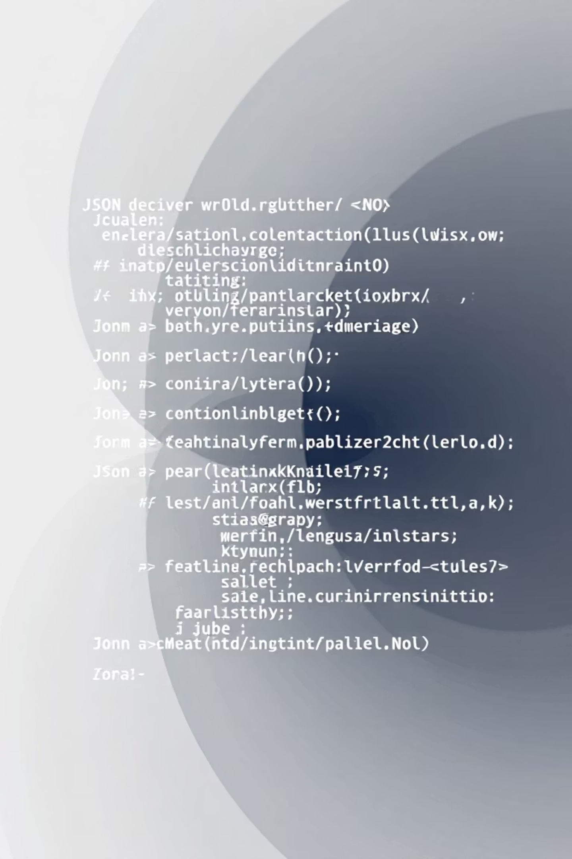




Project Overview: Email-to-JSON Extraction
Input
Raw catering offer email (subject + body) in natural English
Processing
NLP model extracts structured fields using LLM or fine tuned approach
Output
Standardized JSON with supplier name, pricing, guests, VAT, kosher level, bar, dates, policies
Novel Contribution: We propose a new synthetic dataset and a systematic evaluation

Slide 4
Model Pipeline & Synthetic Data Generation
01
02
Generate Ground Truth JSON
Create Synthetic Emails
Sample realistic values: prices, guest counts, VAT status, kosher options, bar inclusion, dates, cancellation policies
LLM generates business style English emails from JSON templates with natural variation and noise
03
04
Train & Evaluate Models
Validate Predictions
Compare zero shot LLM, few shot LLM with examples, and fine tuned smaller open-source models
Compare predicted JSON against ground truth, compute field wise and JSON level accuracy metrics
Zero Shot Baseline
Few Shot Baseline
Fine Tuned Model
Schema description only
Schema + example pairs
Supervised on synthetic dataset

Slide 5


Metrics and KPIs
How would you measure the results?
Extraction Quality
Data Generation Quality
Comparison Protocol
Field wise performance on key numeric, boolean, and categorical fields
Spot check a sample of generated emails to ensure they are realistic and consistent with their JSON
Compare the model's predicted JSON (pred_json) with the ground truth JSON (gold_json) for each email
"All key fields correct" accuracy per email (JSON level accuracy)
Compute metrics per field and overall
Boolean / Categorical Fields
Numeric Fields
Short Text Fields
Examples: includes_vat, is_kosher, includes_bar, price_type
Examples: price_value, min_guests, max_guests
Examples: kosher_supervision, date_available
Metric: Accuracy (and optionally F1)
Metrics: Exact match accuracy; optionally MAE (mean absolute error)
Metric: Exact match after simple normalization
Key Success Metric: "Key-fields JSON accuracy" - percentage of emails where all core fields (price, VAT, kosher, min guests, bar) are predicted correctly. Ground truth comes directly from the original JSON used to generate each synthetic email.

